Slide 1

MAGE.ai
https://medium.com/@eponkratova/airflow-is-not-an-etl-tool-bfa82d20f31e

Slide 2
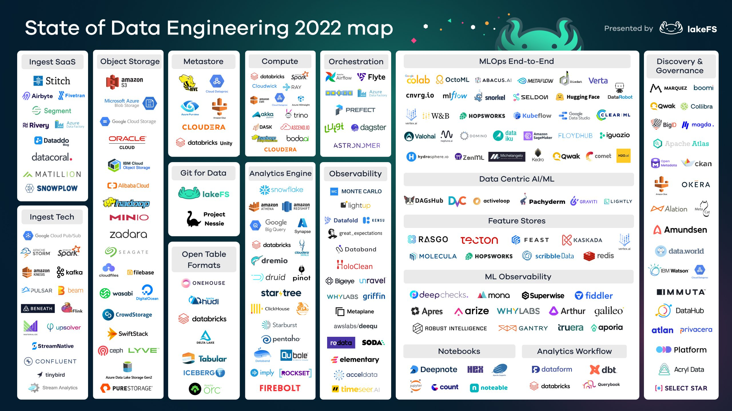
https://lakefs.io/blog/the-state-of-data-engineering-2022/

Slide 3
개발환경
Python download
VS Code download
activate Virtual Environment

Slide 4
Python Virtual Environment
라이브러리 버전 충돌 방지를 위해 설치하고 사용되는 파이썬 인터프리터 환경을 격리하는 기술
라이브러리 설치시점에 따라서도 버전이 달라 충돌 위험을 방지
Airflow
프로젝트
Fast API
프로젝트
venv
venv
A 프로젝트
(a1_library 3.0)
Python(Global)
B 프로젝트
(a1_library 5.0)
OS

Slide 5
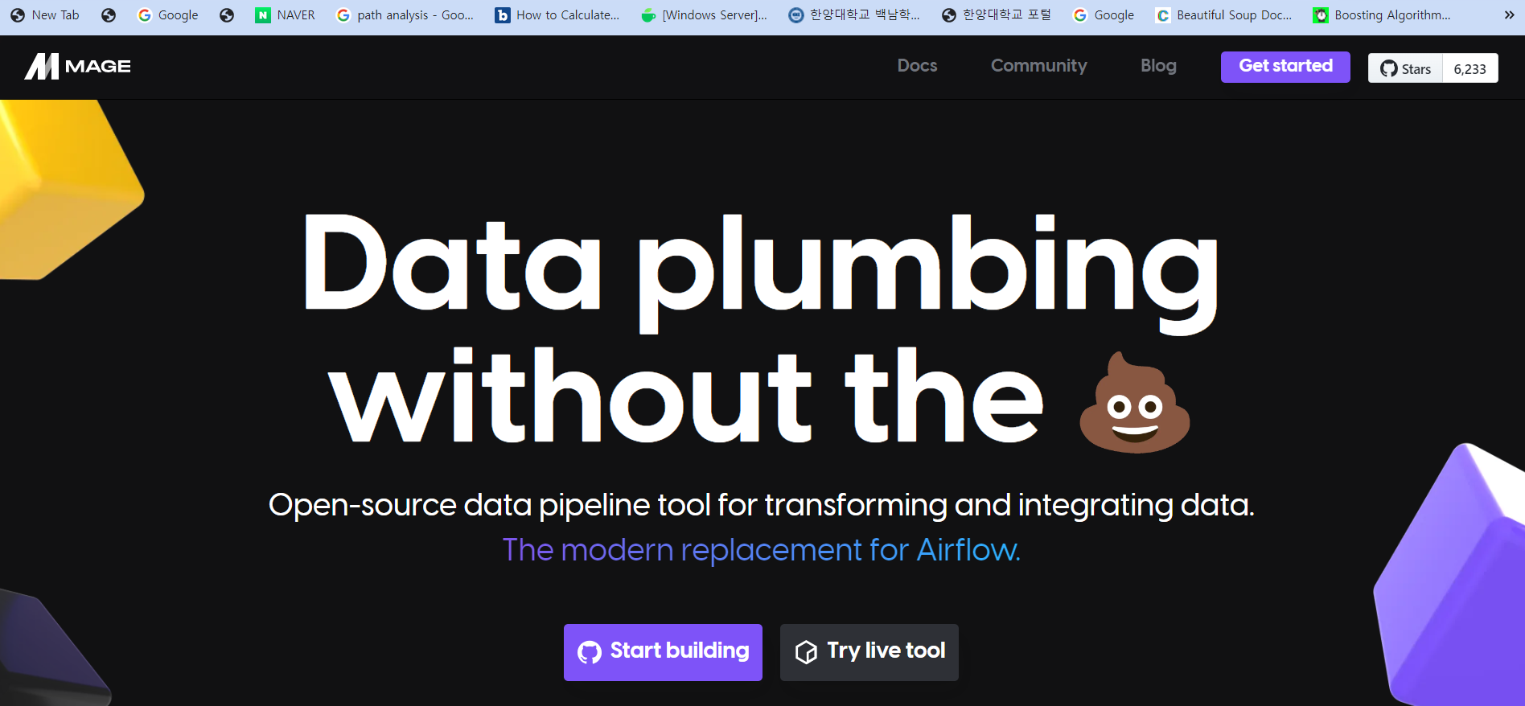

mage.ai

Slide 6
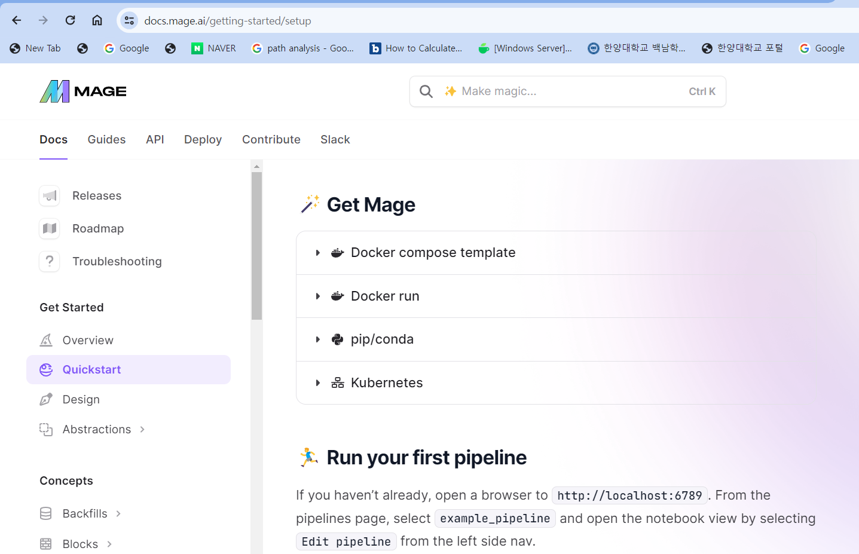
Mage
https://docs.mage.ai/getting-started/setup
git clone https://github.com/mage-ai/compose-quickstart.git mage-quickstart
cd mage-quickstart
cp dev.env .env
rm dev.env
docker compose up

Slide 7
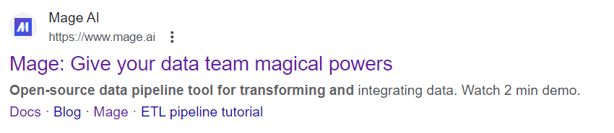
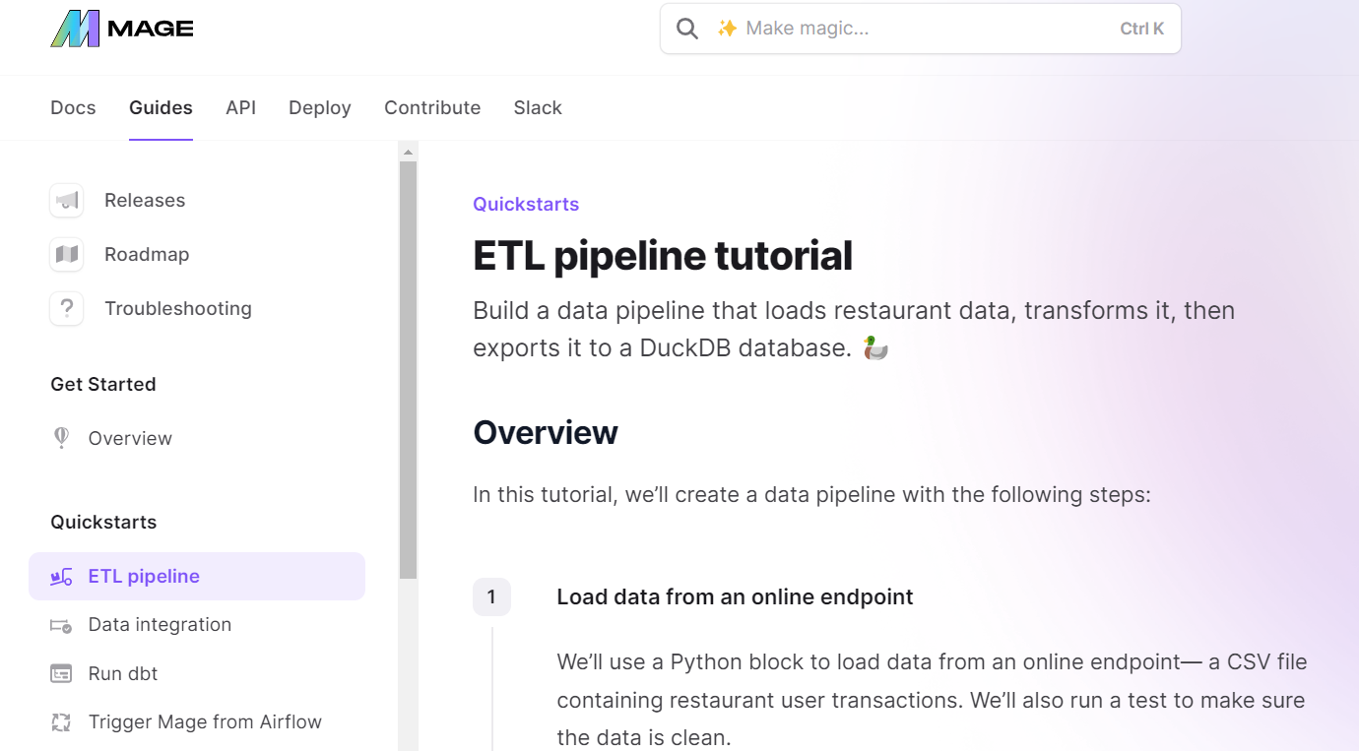
Mage is ETL tool
https://docs.mage.ai/guides/load-api-data

Slide 8
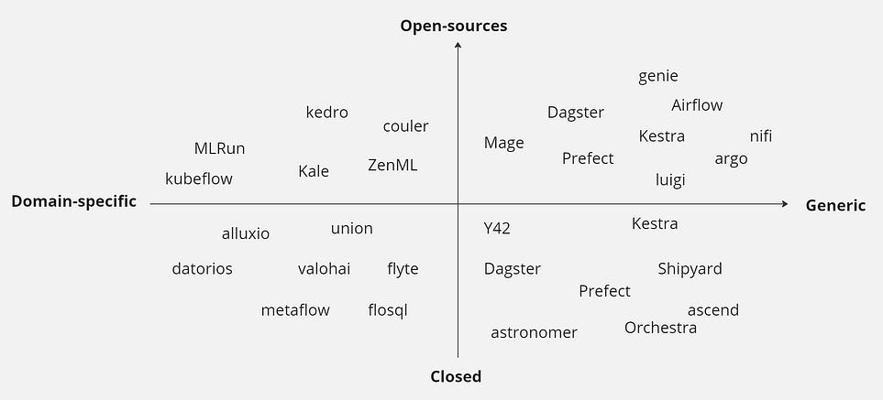
Mage ai

Slide 9
MAGE
Data orchestrators >> Mage
While Apache Airflow and Mage.ai serve different purposes within the data pipeline, both are invaluable in their respective domains.
Airflow excels in orchestrating and automating workflows, whereas Mage.ai shines in simplifying and automating data preparation for machine learning.
Data orchestrators >> Kestra
Data orchestrators >> Dagster

Slide 10

Demo

Slide 11
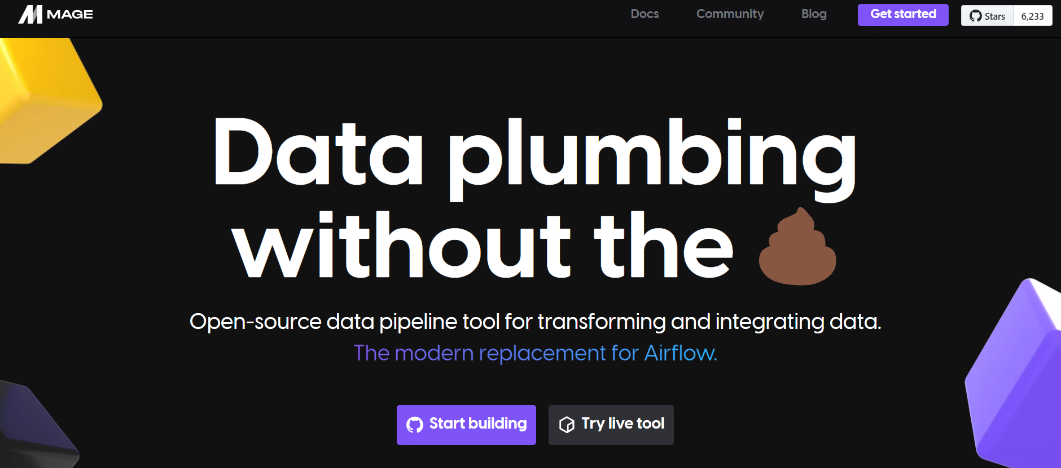

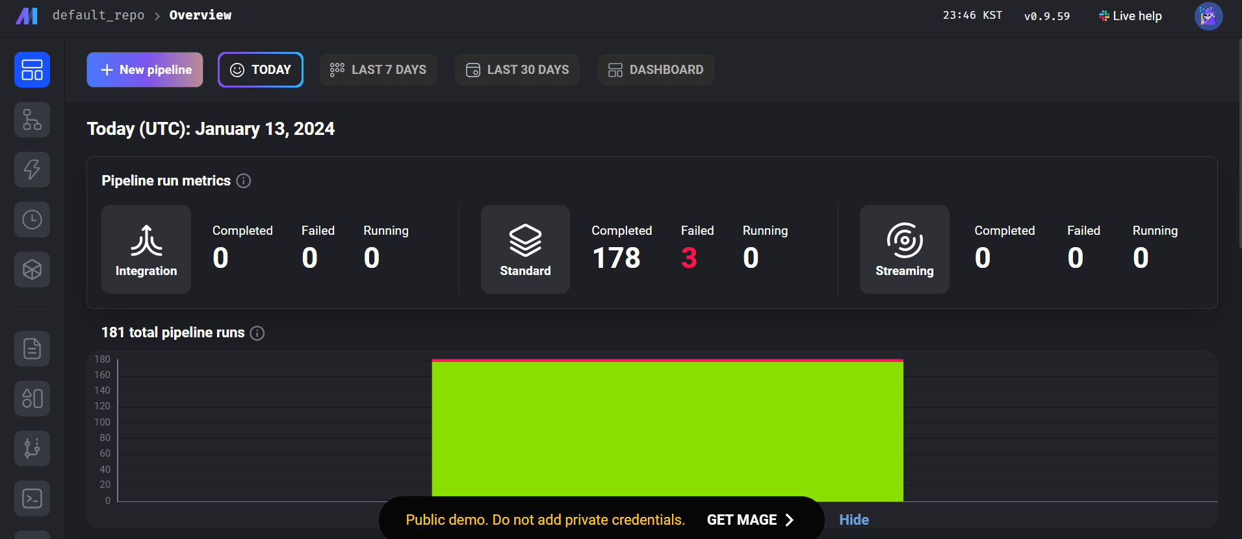
Try live tool

Slide 12
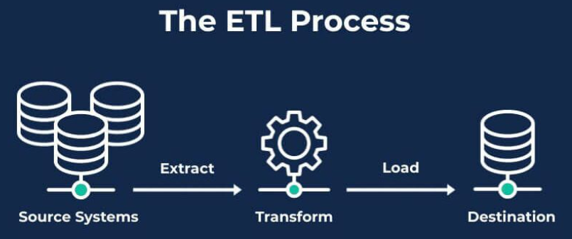
Mage’s Terminology
Pipeline : The blocks of code
Block :
data loader(origin)
transformer
data exporter(destination)

Slide 13

Pipelines
Pipeline1(Blocks), Pipeline2(Blocks), …..……….., Pipeline1000(Blocks)
So many data pipelines for API, transform, machine learning, visualization, etc.
Type of data pipelines depends on the specific purpose like analytics, sales, finance, marketing.
Mage.ai can efficiently orchestrate these complex pipelines.
…………

Slide 14
Titanic_ETL

Slide 15
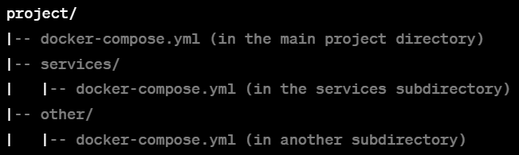
docker-compose.yml
If you navigate to the project/services directory and run docker-compose up, it will use the docker-compose.yml file in the project/services directory to define and run the services specified in that file. It won't be affected by the docker-compose.yml file in the main project directory or any other directories.
This allows for flexibility when working with multiple Docker Compose configurations within the same project or across different projects. Each directory can have its own isolated Docker Compose configuration

Slide 16
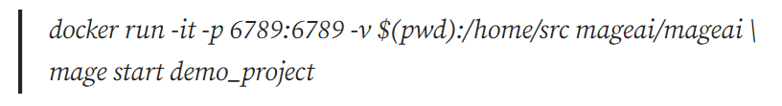
pull Image > run Container
ancestor9@DESKTOP-LMLFU0S:/home$ sudo mkdir zoro1
[sudo] password for ancestor9:
ancestor9@DESKTOP-LMLFU0S:/home$ ls -al
ancestor9@DESKTOP-LMLFU0S:/home$ cd zoro1
ancestor9@DESKTOP-LMLFU0S:/home/zoro1$ docker run -it -p 6789:6789 -v $(pwd):/home/src mageai/mageai \
> mage start demo_project
Unable to find image 'mageai/mageai:latest' locally
latest: Pulling from mageai/mageai
1b13d4e1a46e: Pull complete
1c74526957fc: Pull complete
This command is running a Docker container based on the mageai/mageai image, making it interactive with a terminal, mapping port 6789, and creating a bind mount to share files between the host and the container.
This specific setup might be used for development or testing purposes, where you need to interact with the container, expose a specific port, and share files between the host and the container.
Hit the url http://localhost:6789/

Slide 17
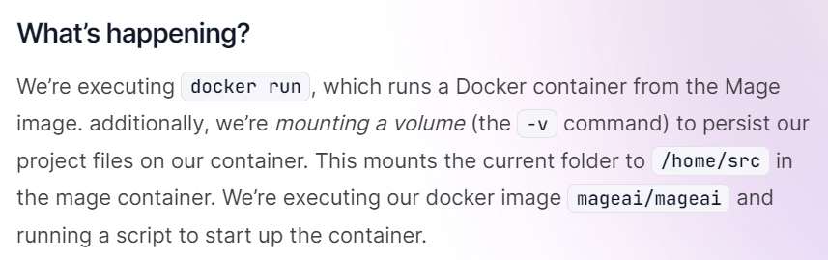
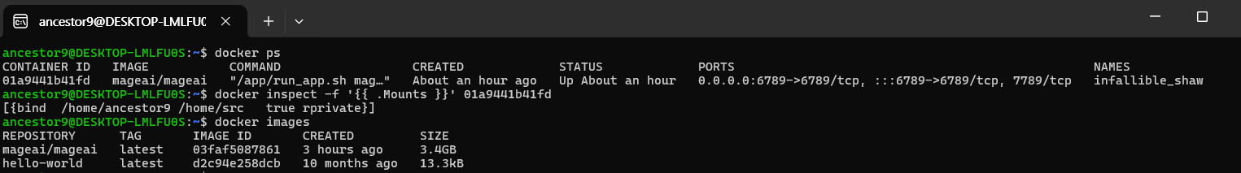
pull Image > run Container
This confirms that your local directory /home/ancestor9 is correctly mounted to /home/src inside the running Docker container named infallible_shaw. You can now access and manipulate files within this directory from the container, and any changes will reflect on your host in real time.

Slide 18
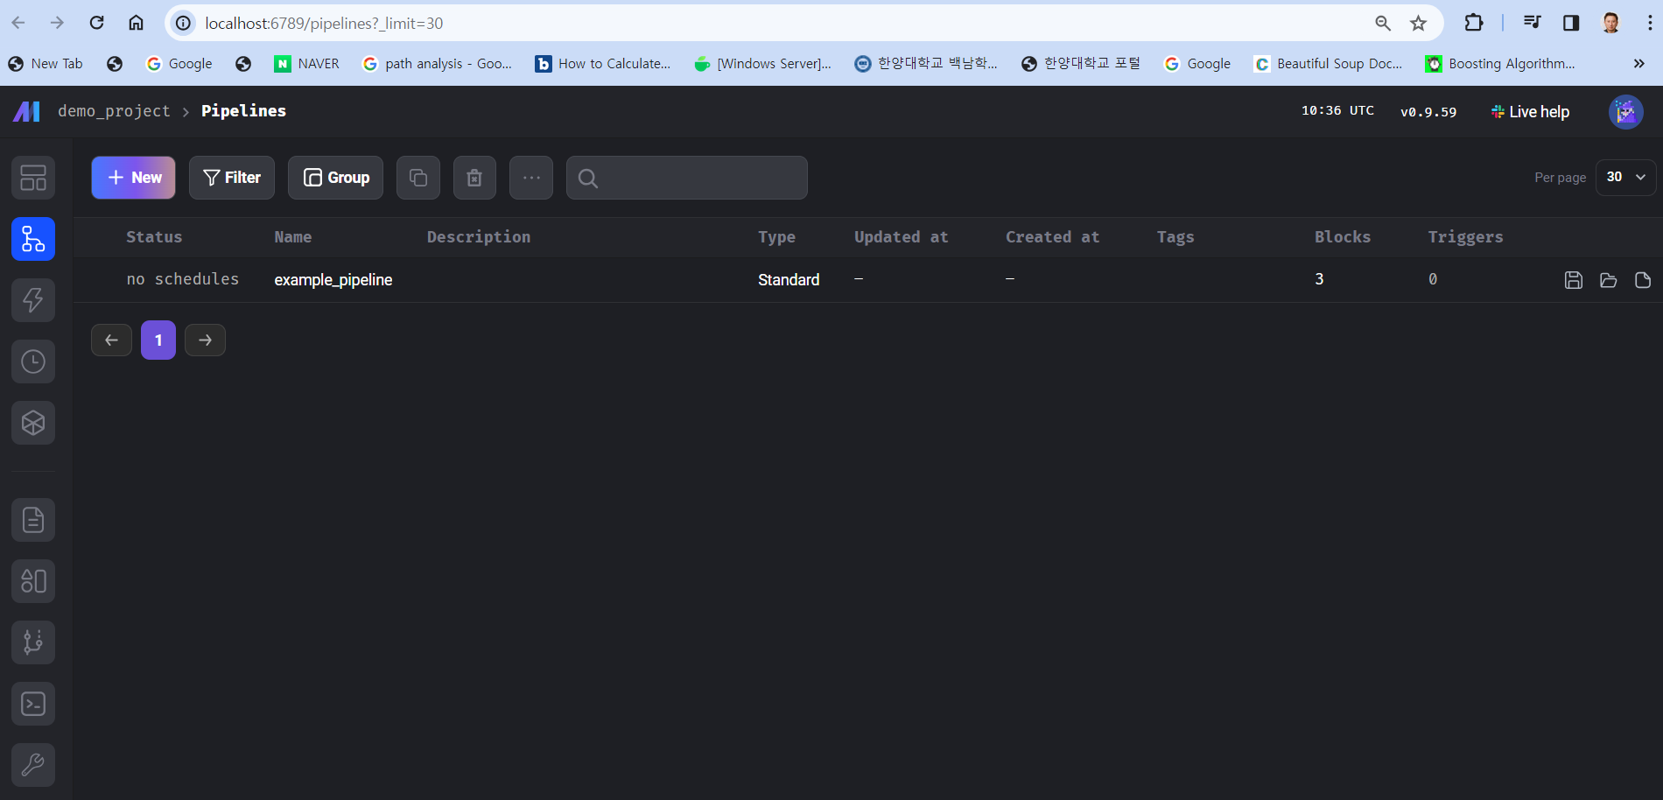
Hey there, I’m using Mage!
Wow, This is a pre-created pipeline already. Let’s have a fun with mage.

Slide 19
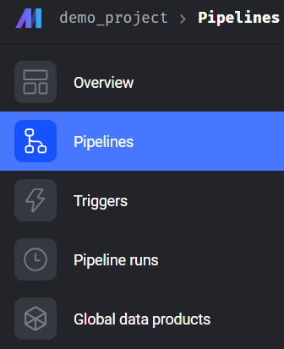
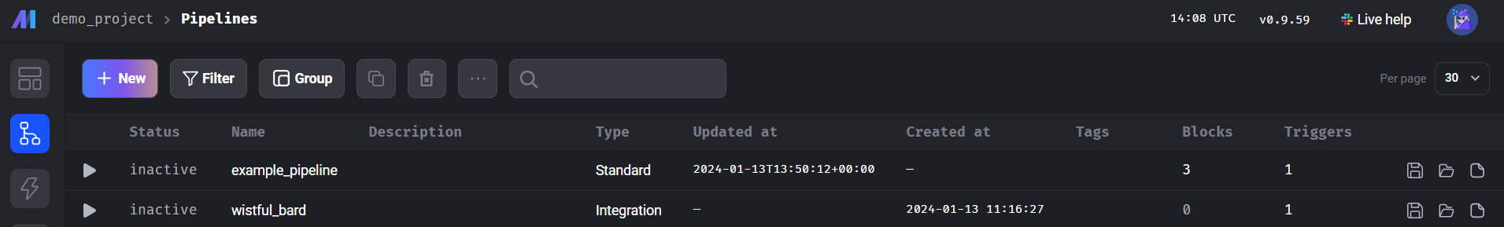
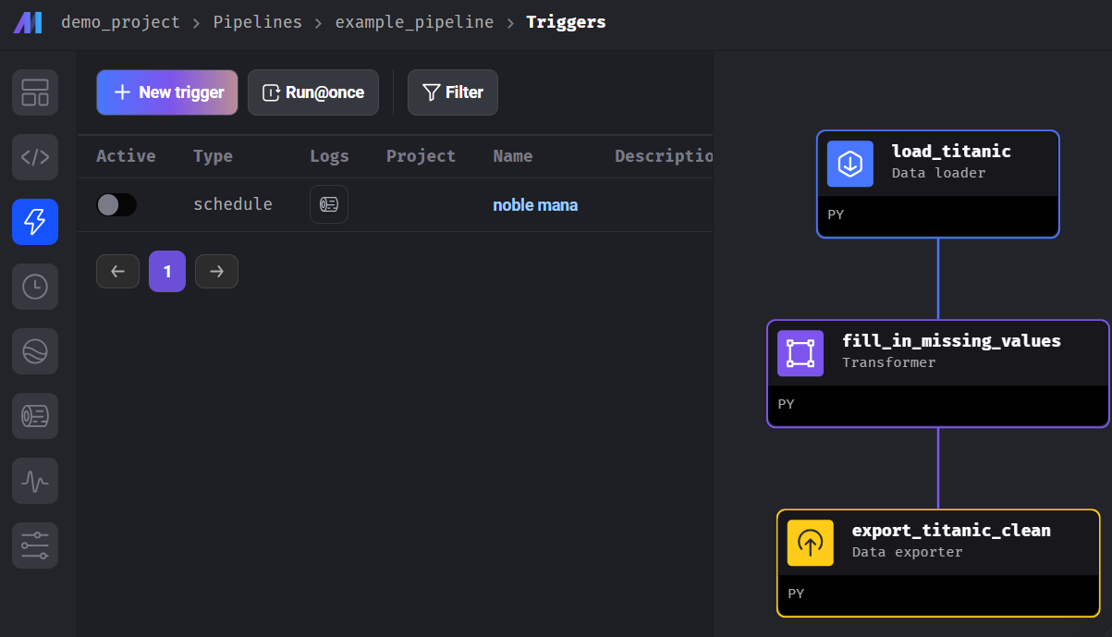
MAGE_Titanic ETL

Slide 20
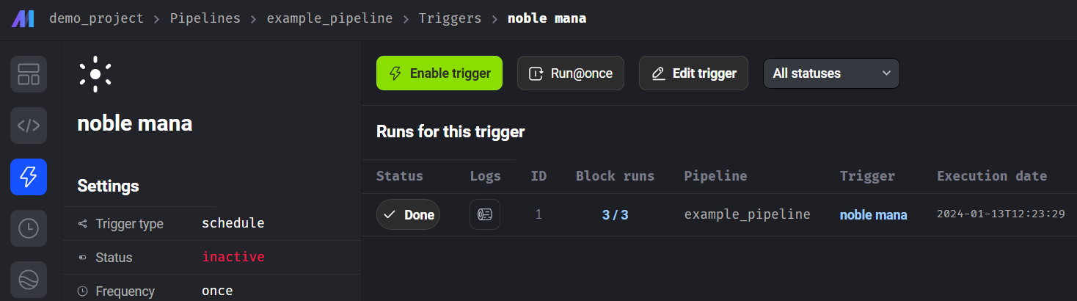
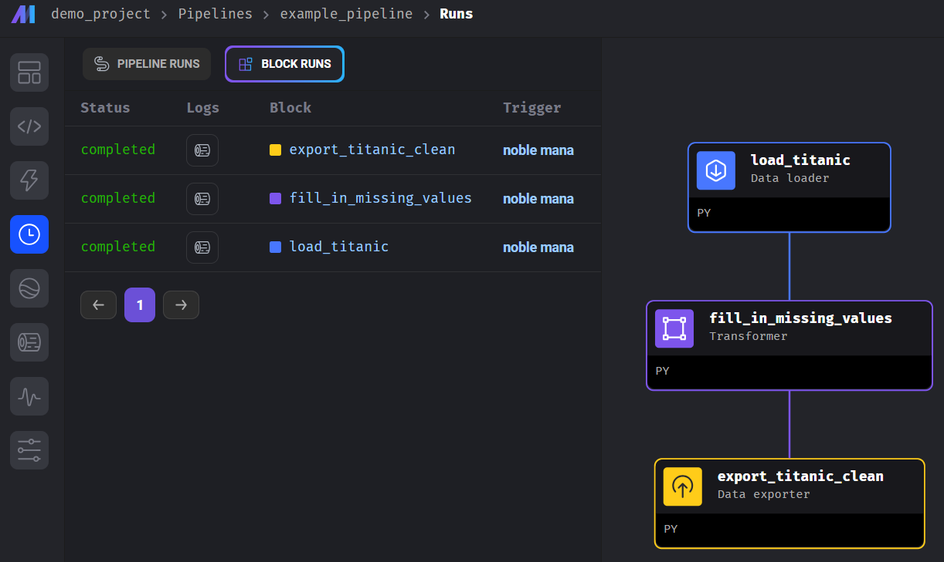
MAGE_Titanic ETL
pipelines : The blocks of code
Blocks :
data loader
transformer
data exporter ….

Slide 21
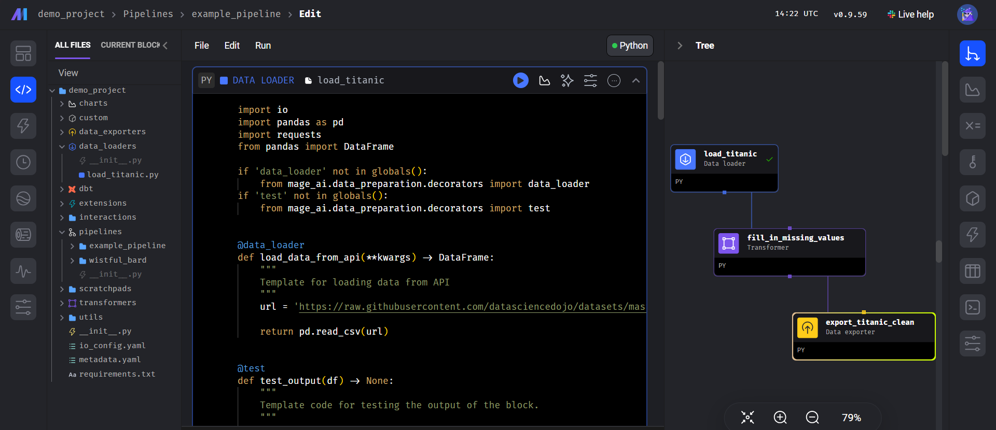
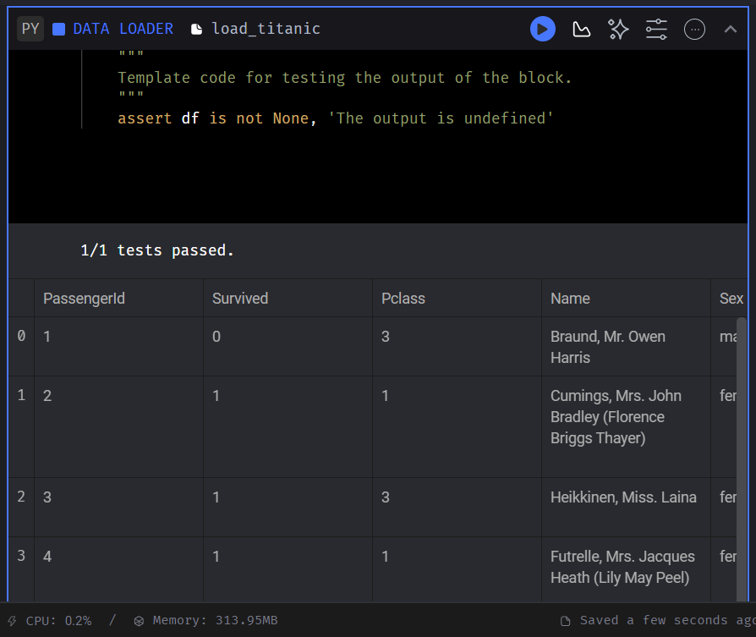
MAGE_Titanic ETL

Slide 22
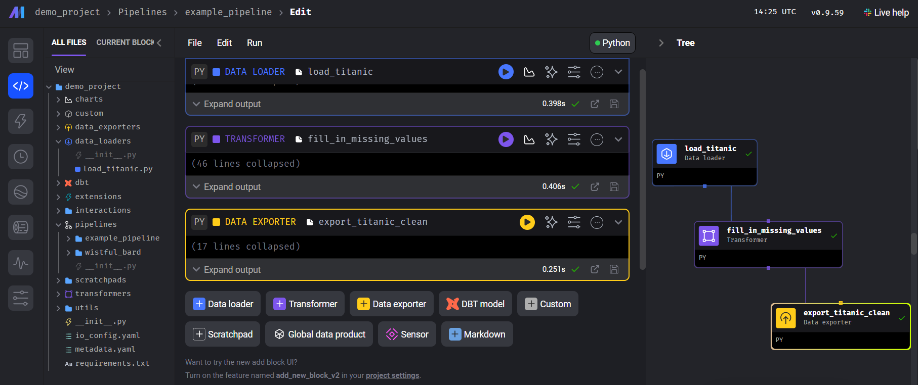

MAGE_Titanic ETL

Slide 23
실습하기
Understanding
mage project

Slide 24
예제 파일 가져오기
https://github.com/mage-ai/mage_demo_project?tab=readme-ov-file
Setup
Set up Mage by following this guide.
After you install Mage, clone this repository.
After you clone the repository, start Mage from the folder above mage_demo_project/.
When you start Mage, be sure to reference the project name mage_demo_project. For example, mage start mage_demo_project

Slide 25
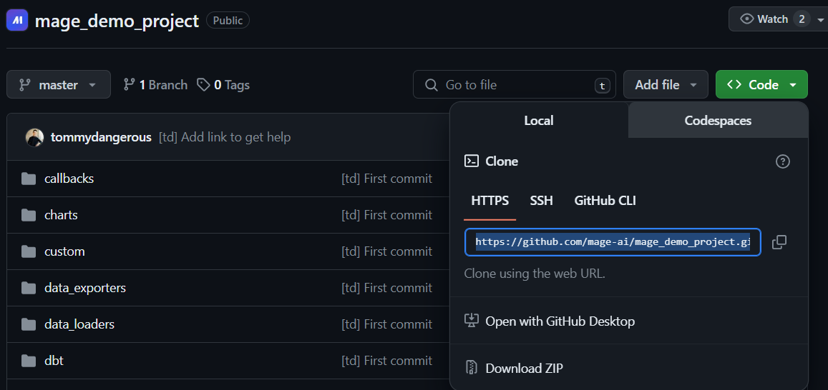
예제 파일 가져오기
mage 폴더에서 git clone [깃허브 repository 주소]
(mage) C:\python\etl\mage>git clone https://github.com/mage-ai/mage_demo_project.git

Slide 26
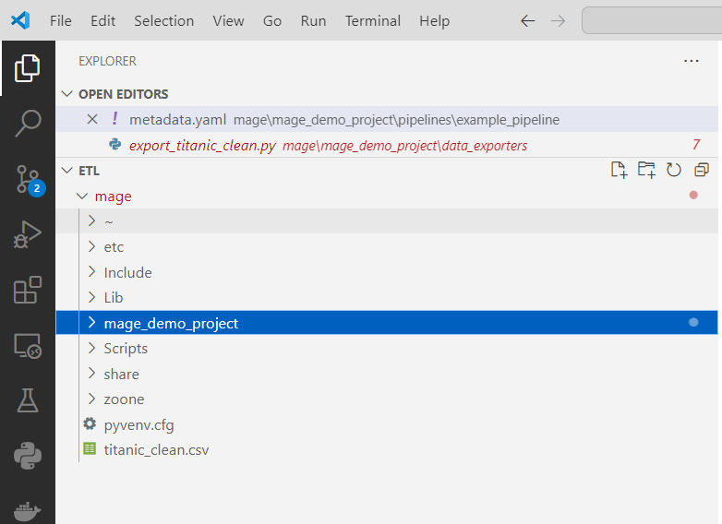
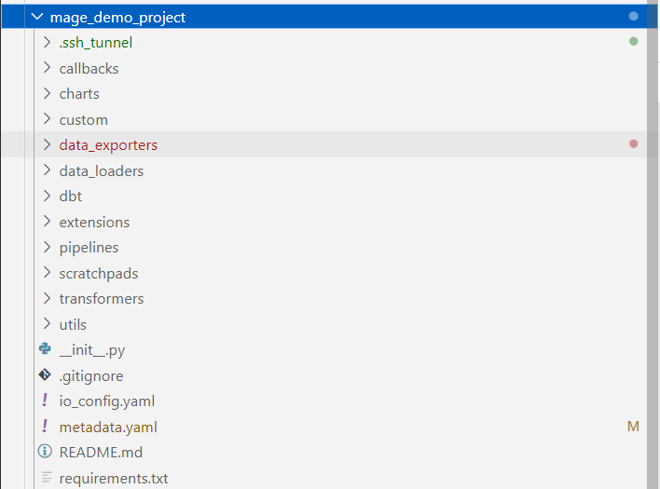
예제 파일 가져오기
(mage) C:\python\etl\mage>mage start mage_demo_project

Slide 27
mage Architecture
User Interface (UI): A web-based platform that allows users to create, manage, and monitor data pipelines.
Pipeline Engine: The core system that executes the data pipeline as defined by the sequence of blocks.
Blocks: The individual steps of a pipeline, each performing a specific task.
Extraction Blocks: Pull data from various sources such as databases, APIs, or files.
Transformation Blocks: Clean, manipulate, and transform the data using predefined functions or custom code.
Loading Blocks: Push the transformed data into a storage system or database.
Machine Learning Layer: Provides suggestions for data transformations and automates repetitive tasks.
Data Storage: Databases or file systems where raw data is stored before processing and where transformed data is stored after processing.

Slide 28
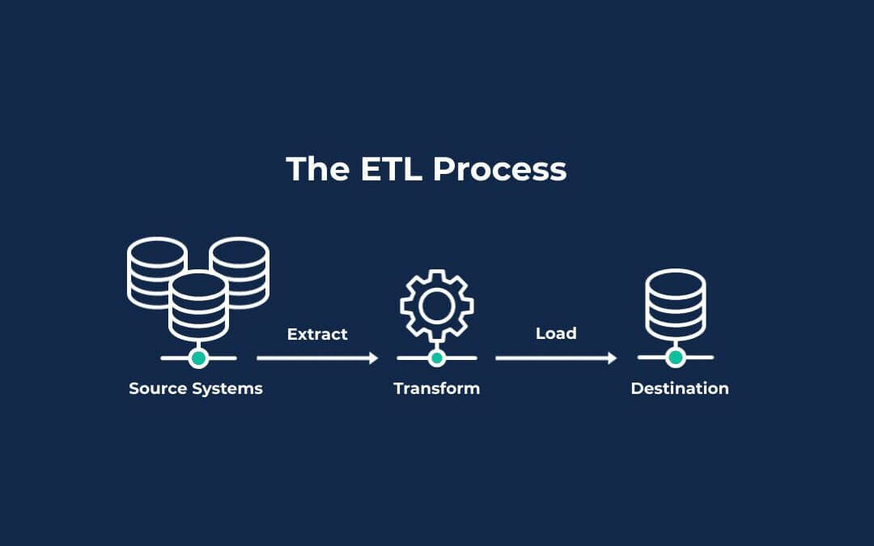
mage Workflow (block/pipeline)
The ETL Pipeline
Workflow
Extract block
Transform block
Load block

Slide 29
mage Workflow
The typical workflow in Mage.AI involves the following steps:
Data Extraction: The first block in the pipeline extracts data from the specified sources.
Data Transformation: The extracted data is then passed through one or more transformation blocks, where it is cleaned and transformed into the desired format. This is where machine learning can be used to suggest transformations.
Data Loading: After the data has been transformed, loading blocks are used to load the data into a target system for storage or further analysis.
Monitoring and Management: The user can monitor the pipeline's progress and manage it through the UI.

Slide 30
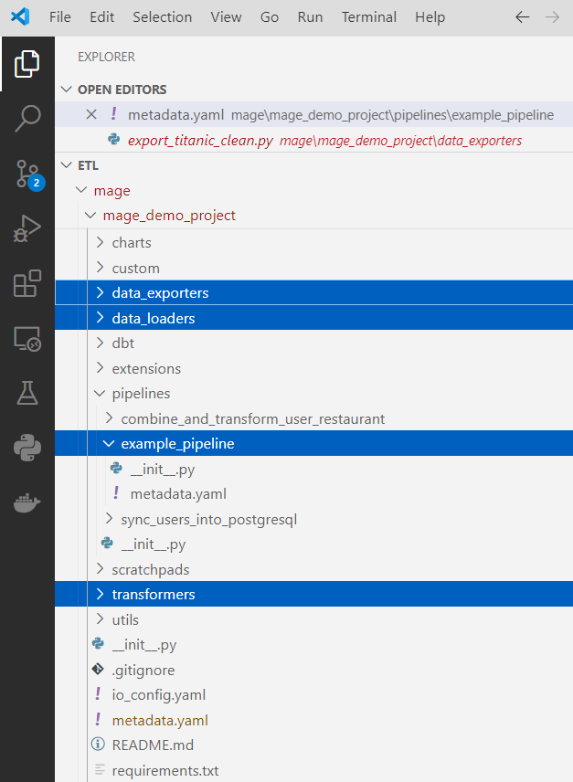
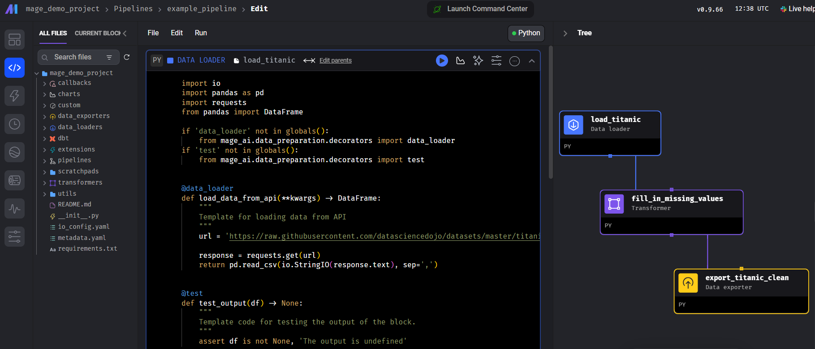
mage Workflow
pipeline에 3개의 blocks의 workflow로 구성하는 파일은 metadata.yaml 파일로 작동
3 blocks(data_loaders/transformers/data_loaders)
titanic 예제 : load_titanic, fill_in_missing_values, export_titanic_clean 파이썬코드

Slide 31
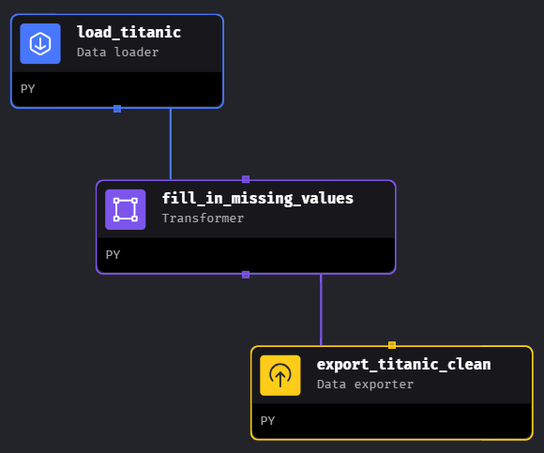
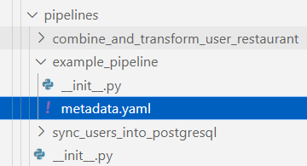
matadata_yaml 파일
blocks:
- all_upstream_blocks_executed: true
downstream_blocks:
- fill_in_missing_values
name: load_titanic
status: not_executed
type: data_loader
upstream_blocks: []
uuid: load_titanic
- all_upstream_blocks_executed: true
downstream_blocks:
- export_titanic_clean
name: fill_in_missing_values
status: not_executed
type: transformer
upstream_blocks:
- load_titanic
uuid: fill_in_missing_values
- all_upstream_blocks_executed: true
downstream_blocks: []
name: export_titanic_clean
status: not_executed
type: data_exporter
upstream_blocks:
- fill_in_missing_values
uuid: export_titanic_clean
name: example_pipeline
type: python
uuid: example_pipeline
widgets: []

Slide 32
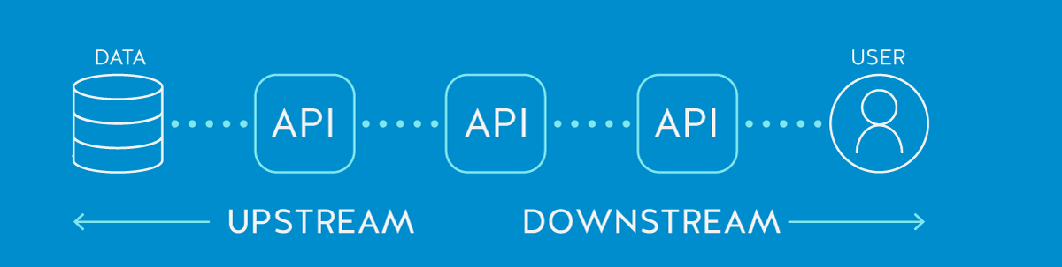
yaml 파일
blocks:
- all_upstream_blocks_executed: true
downstream_blocks:
- fill_in_missing_values
name: load_titanic
status: not_executed
type: data_loader
upstream_blocks: []
uuid: load_titanic
- all_upstream_blocks_executed: true
downstream_blocks:
- export_titanic_clean
name: fill_in_missing_values
status: not_executed
type: transformer
upstream_blocks:
- load_titanic
uuid: fill_in_missing_values
- all_upstream_blocks_executed: true
downstream_blocks: []
name: export_titanic_clean
status: not_executed
type: data_exporter
upstream_blocks:
- fill_in_missing_values
uuid: export_titanic_clean
name: example_pipeline
type: python
uuid: example_pipeline
widgets: []
https://nordicapis.com/whats-the-difference-between-upstream-and-downstream/upstream-downstream-api-data/
각 블록은 데이터를 처리/변환하는 단계를 나타내며, 파이프라인의 데이터 흐름을 나타내며 각 블록은 다음과 같은 속성을 나타냄
name: 블록의 이름
type: 블록의 유형 → 데이터 로딩, 변환 또는 내보내기 등 작업을 수행
status: 블록의 실행 상태로 아직 실행되지 않았음으로 설정
upstream_blocks: 현재 블록에 대해 의존하는 이전 단계의 블록
downstream_blocks: 현재 블록에 의존하는 이후 단계의 블록
uuid: 블록을 고유하게 식별하는 UUID입니다.

Slide 33
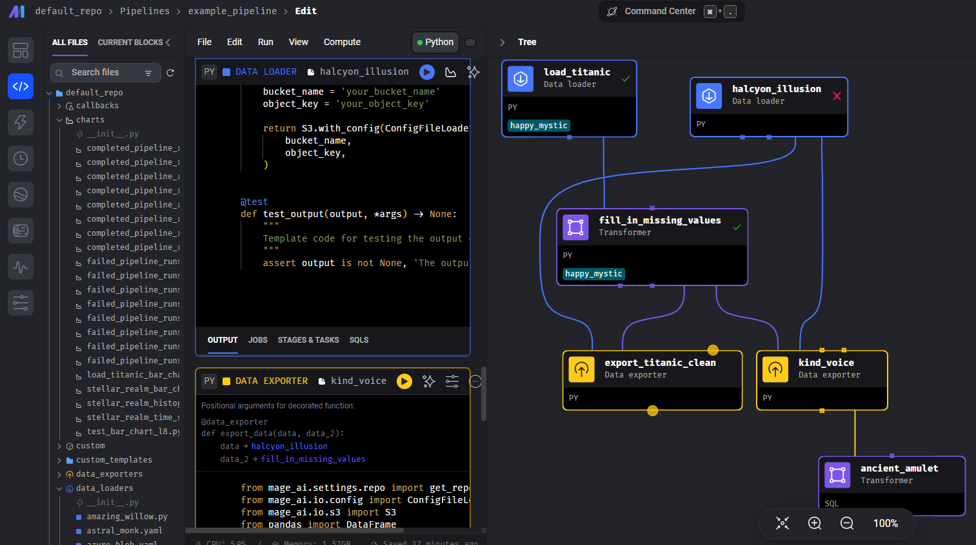
Many blocks < example_pipeline < pipelines

